Slide 1
Drone detection using Open-Cv

Slide 2
Abstract:
Main use of this project is to detect the drone at any type. We can detect with in seconds using YOLO with RCNN. using this we can detect drones,. Yolo gives better output and taking less speed than others.

Slide 3
Introduction:
Drones are known as Unmanned Aerial Vehicles (UAV) is an aircraft without a human pilot aboard. Drones may operate with various degrees of autonomy either under remote control by a human operator or autonomously by onboard computers

Slide 4
Objective:
The aim of the project is to detect the drones using yolo and deep learning with in less time to provide security in restricted areas. We can use in borders, government secure areas.

Slide 5
Existing method:
In existing analysis we used convolution neural network for the classification but we need quick response to get the better accuracy.but without yolo its too late.
CNN
MOBILENET

Slide 6
Disadvantages:
Less accuracy
Low speed
Image classification

Slide 7
Proposed method:
Proposed method:
YOLO
RCNN
DARKNET
Pre-process

Slide 8
Advantages :
High speed
Stronger
More accuracy
Less time taken
Applications:
Face detection.
Vegetables detection.
At car accidents.

Slide 9
Software and hardware requirements:
Software requirements:
PYTHON IDLE
ANACONDA NAVIGATOR
JUPYTER NOTEBOOK
OPENCV
NUMPY
Hardware requirements:
WINDOWS 10 OS PC 64 BIT
MINIMUM 4GB RAM

Slide 10
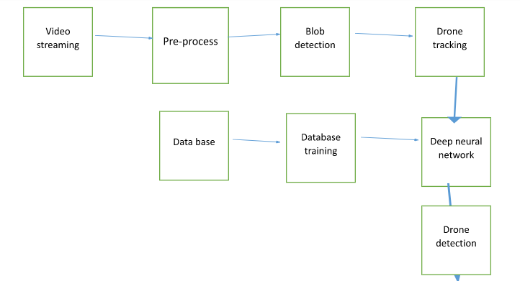
System diagrams: system architecture:

Slide 11
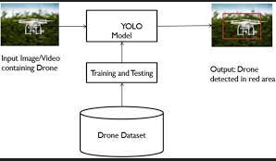
ER diagram:

Slide 12
DFD diagram:
Input video
Pre-process
Blob detection
Yolo and dnn
Drone detection
Data base

Slide 13
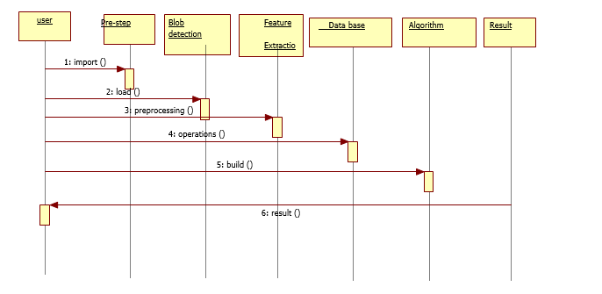
Uml diagram:
Sequence:

Slide 14
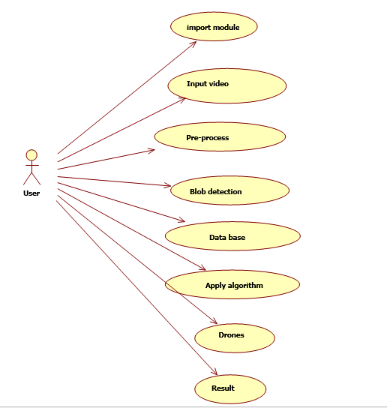
Use case diagram:

Slide 15
Algorithm and modules:
Video streaming:Video streaming technology is one way to deliver video over the Internet. Using streaming technologies, the delivery of audio and video over the Internet can reach many millions of customer using their personal computers, PDAs, mobile smartphones or other streaming devices.
Pre-processing :in this step we have to reduce the complexity of the picture of license plate using resize and the conversion.using these pre-process we can change the size of the license plate using resize.
DNN:Deep neural networks. A deep neural network (DNN) is an artificial neural network (ANN) with multiple layers between the input and output layers. There are different types of neural networks but they always consist of the same components: neurons, synapses, weights, biases, and functions.

Slide 16
Features Extraction:Point birth for machine literacy and deep literacy. Point birth refers to the process of transubstantiating raw data into numerical features that can be reused while conserving the information in the original data set.
RCNN:Region convolutional neural network. It is two stage of cnn. using this we can detect object easily with grid lines for the classification.
Yolo: You Only Look Once — is an extremely fast multi object detection algorithm which uses convolutional neural network (CNN) to detect and identify objects. The neural network has this network architecture.

Slide 17
References:
Mohapatra, Hitesh. (2015). HCR (English) using neural network. International journal of advance research and innovative ideas in education, 1(4), 379385.
Mohapatra, H., & Rath, A. K. (2019). Detection and avoidance of water loss through municipality taps in India by using smart taps and ICT. IET Wireless sensor systems, 9(6), 447-457.
Mohapatra, H., & Rath, A. K. (2019). Fault tolerance in WSN through PE-LEACH protocol. IET wireless sensor systems, 9(6), 358-365.
Mohapatra, H., Debnath, S., & Rath, A. K. (2019). Energy management in wireless sensor network through EB-LEACH (No. 1192). Easy Chair.
Nirgude, V., Mahapatra, H., & Shivarkar, S. (2017). Face recognition system using principal component analysis & linear discriminant analysis method simultaneously with 3d morphable model and neural network BPNN method. Global journal of advanced engineering technologies and sciences, 4(1), 1-6.

